Slide 1


Female Burnout
TRAINING SEMINAR

Slide 2

Overview
Defining Stress and Burnout
Understanding Burnout for Women
Stress Cycles and Self-care
Q and A
Notes:
Trainer:
Introduce yourself and the session
Overview aims:
Understand similarities and differences between stress, burnout and compassion fatigue
Understand what compassion fatigue is, how it develops (stages) and symptoms associated with compassion fatigue
Learn to recognise early signs, symptoms and behaviours indicating burnout and compassion fatigue developing
Understand compassion fatigue and burnout as occurring on a continuum with varying low to high individual impacts
Learn prevention and management strategies for compassion fatigue (including resilience building and self-care)
Develop your own compassion fatigue wellness plan with focus on meaning and purpose, self-efficacy, meaningful social support and physical health

Slide 3
Stress Defined
Baum (1990) and Derogatis (1987) describe stress in terms of an uncomfortable emotional experience or feeling of pressure influenced by a person’s personality, environment and emotional response
Hans Selye’s (1936) definition:
“the non-specific response of the body to any demand or change”
Notes:
NOTES FOR TRAINER:
No definition can comprehensively describe a qualitative phenomenon such as stress.
Essentially, stress is the emotional and physical response experienced when perceive an imbalance between demands placed on you, and resources at a time when coping is important
Generally agreed that stress involves discomfort and pressure – highly variable and subjective
To do list/pile

Slide 4
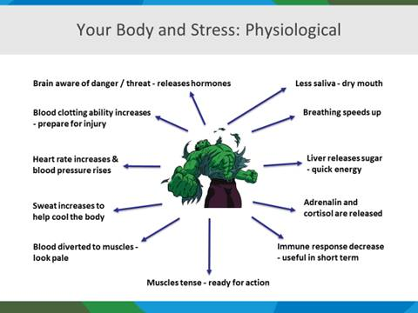
Notes:
Flight Fright Freeze Response to Stressor
Stress response
Parasympathetic nervous system – and the vagus nerve – relaxation response

Slide 5
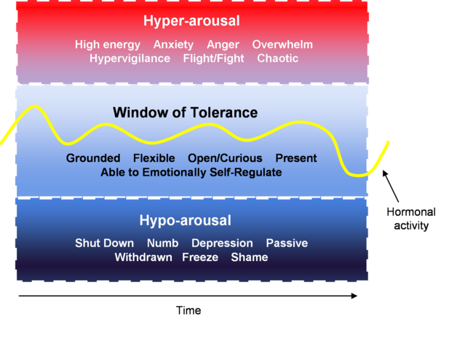
Window of Tolerance (Dan Siegel, 1999)

Slide 6

Burnout defined
Exhaustion
Alienation from work related activities
Reduced performance
Chronically stressed
Without adequate coping mechanisms
Burnout: Physical, emotional and mental exhaustion from a build up of too much stress
Schaufeli and Greenglass, 2001
Notes:
Trainer: definition and symptoms
Burnout: Characterised by:
Exhaustion: Feelings of fatigue and emotional, psychological or physical exhaustion
Cynicism: Indifferent or distant attitude towards one’s work
Reduced professional efficacy: Negative attitude towards one’s own performance in relation to the job

Slide 7
The WHO states that burnout is characterised by:
feelings of energy depletion or exhaustion
increased mental distance from one’s job
feelings of negativism or cynicism related to one's job
reduced professional efficacy

Slide 8
Stress Vs Burnout
Stress (too much) | Burnout (not enough)
Characterized by over-engagement. | Characterized by disengagement.
Emotions are overreactive. | Emotions are blunted.
Produces urgency and hyperactivity. | Produces helplessness and hopelessness.
Loss of energy. | Loss of motivation, ideals, and hope.
Leads to anxiety disorders. | Leads to detachment and depression.
Primary damage is physical. | Primary damage is emotional.
May kill you prematurely. | May make life seem not worth living.

Slide 9
Cycle of burnout
Emotional Exhaustion
Reduced sense of accomplishment or meaning
Mental exhaustion
Decreased interactions with others (isolation)
Physical exhaustion
Notes:
Trainer:
These are some common stages people go through if they are feeling burnout or experiencing compassion fatigue.
There can be first just a sense of emotional exhaustion. This can manifest in different ways for different people
ASK – how would someone close to you know that you might be feeling emotionally exhausted? How would you know?
People might respond with – can’t be bothered talking on the phone, don’t want to go out, go to be by 8.30pm!!; seem teary;
You might also begin to feel that you are less effective at work and in other parts of your life as well. You might not be enjoying work
There can follow a mental exhaustion. Can’t be bothered reading or engaging in anything that is too challenging.
With burn out and compassion fatigue you may also find that you are less connected with people than you were before.
And of course physical exhaustion can occur too. Just feel unable to exercise, feel tired all time. You may be more vulnerable to colds and infections and find you can’t throw things off like you used too.

Slide 10
Gender and Burnout
Turn to the person next to you and discuss:
Why be curious about gender differences in relation to burnout?
What is your experience (self/friend/colleague) with burnout and stress?
Notes:
Women tend to contribute to assisting others with burnout in the workplace

Slide 11
Female Burnout
Male burnout tends to manifest more in a sense of depersonalisation; i.e. feeling disconnected or detached from oneself
Female burnout tends to manifest more in emotional exhaustion and a sense of emotional overwhelm (more likely to push through and keep working even harder)
(Emily and Amelia Nagoski, 2021)
Notes:
Human Giver Syndrome phenomenon
Boundaries and assertiveness

Slide 12
Stress vs Stressors
Stressors activate the stress response in our bodies
Stressors can be internal or external to our bodies
Stress is the physiological shift that happens when we encounter these stressors (normal and adaptive)
Notes:
stressor

Slide 13
Complete the Stress Cycle
When we complete the stress response cycle after a stressful event, this brings our bodies back to a feeling of safety
Getting stuck in a stress cycle can lead to burnout
Some ways to complete a stress cycle:
Breathing
Exercise/movement
Positive social interaction
Laughter
Creativity
Cry
Affection
Notes:
Completing the stress cycle helps to expel adrenaline from major muscle groups and prompts our body that it is safe
Sabre tooth tiger concept

Slide 14

STOP technique
S
Stop what you’re doing
T
Take a few deep breaths
O
Observe your experience - thoughts, feelings, body
P
Proceed with something that will help you in the moment
Notes:
E= Engage
This exercise can be used to focus as well as pause for stress
Engaging in what we are doing allows us to stay in the present moment and resist the temptation to become anxious about the future. Whatever you choose to do e.g. listen to music, work, play with your children, stay present.

Slide 15

What is an EAP?
Short-term assistance for work-related and personal issues
A confidential, independent and professional support service
How many sessions?
Manager Assist, Training Products, Consulting Support & Rapid Response
Notes:
Talk about EAP.
-At______________COGD____? You have ___4___ sessions per year, per issue
-Counselling is accessed for personal or professional concerns
-Confidentiality: We invoice back to the organisation via a job number not your name
-Locations state/nation wide
Talk about Manager Assist
Manager Assist is designed to assist managers and supervisors to deal with the demands of their roles such as;
Assisting with work pressures/demands
Coping strategies for stressful environments
External feedback to assist workplace interventions
Managing mental health in the workplace
Challenging conversations in the workplace
Talk about Rapid Response
Psychological First Aid provided for when a crisis occurs in your workplace and you require critical incident management. You will receive support from a Senior Psychologist who will assist managers, employees and organisations recover from a stressful event.
Talk about Training and Consulting
Converge International believes that employee learning never stops, which is why we offer an extensive range of training programs to meet the changing needs of workplaces, their teams and their staff. We also provide consulting services such as mediation, well-being checks, team assessments and coaching around leadership culture and change.
If you would like to know more about our services or make an appointment please contact 1300 OUR EAP.
Thank you.

Slide 16

Training Seminars/Programs Well-being
Conflict Resolution
Leadership, Culture and Change
HR Consulting
Mental Health
Team Assessments
EAP Plus
Career/Outplacement Services
Coaching
Contact Converge 1300 687327 | OUR EAP | www.convergeinternational.com.au

