Slide 1

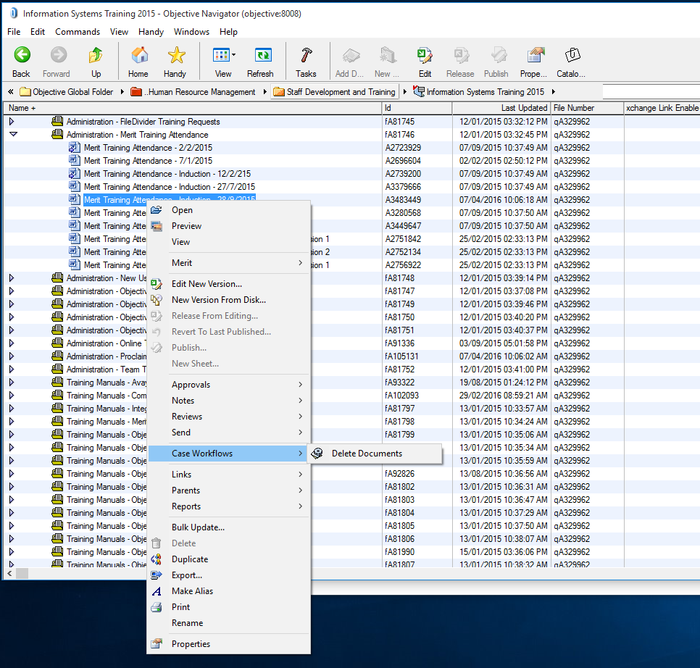
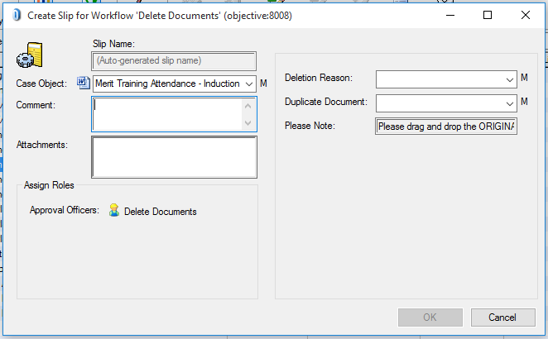
Objective Deletion Requests
1. Right-click, Delete Documents
2. Provide details and press OK
Object to be deleted.
Select Reason & if duplicate.
If selected “Yes” in Duplicate Document field, drag original document here.
PLEASE DO NOT RENAME ORIGINAL UNTIL REQUEST HAS BEEN PROCESSED.

