Slide 1
Unit 1: Understanding Procurement in the City of Greater Dandenong
August 2024

Slide 2
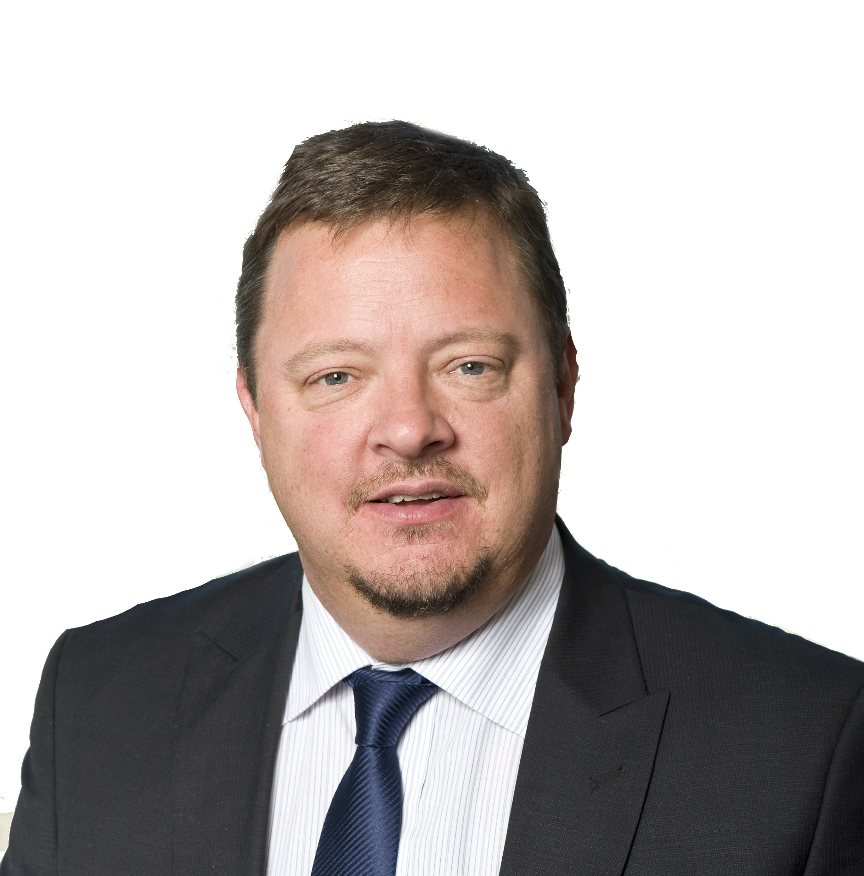
Your facilitator
CHRIS NEWMAN
Managing Director
ArcBlue Consulting

Slide 3











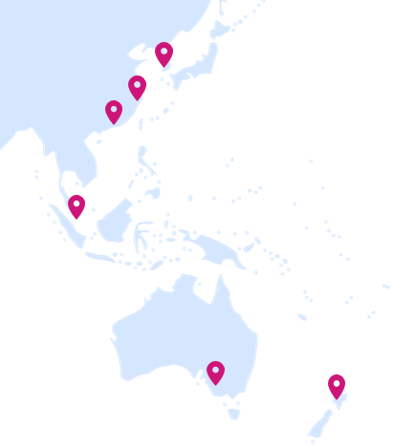











ArcBlue | We are APAC’s leading procurement & supply chain consulting company
About Us
How we work
Our Values
We are...
Established in 2013, ArcBlue started with the mission to support organisations to deliver more from their procurement activities.
ArcBlue delivers end-to-end procurement advisory services across the Asia Pacific region built upon the experience of pragmatic procurement practitioners​​.
After years of successful partnership, ArcBlue is now wholly owned by Bain & Company.
Authentic
Passionate
Bold
Practical, hands-on advice
Support to deliver and embed the change you seek
Curious
Committed to Sustainability
One Team
Advice from practitioners who have been in your shoes
We leave you with tools & resources to build internal capability
Our cultural values to ensure our people are happy and our clients experience a consistently high level of service in every engagement.
1000+
Our Solutions
Worked with
Organisations
150 consultants
10 offices
ADVISORY & CHANGE
ANALYTICS & TECHNOLOGY
LEARNING & DEVELOPMENT
SAVINGS PROGRAMS
Deliver more value through consulting, change & transformation
Gain valuable insights & utilise best-of-breed technology
Unlock more potential for your team & build sustainable talent growth
Take short-term costs out of your business & deliver sustainable savings
in
Industries
20+
In key locations across Asia Pacific including, Singapore, Hong Kong, Australia & New Zealand
SOCIAL & SUSTAINABLE PROCUREMENT
Experienced in
SEARCH & RECRUITMENT
STRATEGIC
SOURCING
SUPPLY CHAIN MANAGEMENT
22+
Direct & indirect categories
Connect with quality candidates for procurement & supply chain roles in Asia
Empowering procurement to make sustainable impact every day
Leverage your purchasing power to future-proof your supply chain​
More competitive, efficient and resilient supply chains

Slide 4
Agenda
Chapter | Content
Introductions and housekeeping | Introductions Housekeeping Learning objectives
Purpose and benefits of procurement | What is procurement? Why is it important? Understanding procurement
Procurement principles | Procurement principles Case study Governance
How procurement works in CGD | Procurement within CGD Business partnering Roles and responsibilities Governance
Procurement processes | Procurement processes Variations and extensions The Procurement Guidelines, templates and forms
Summary | Summary Information sources Feedback survey
1
2
3
4
5
6

Slide 5
01.
Introductions and housekeeping

Slide 6

Introductions

Slide 7
Housekeeping
Emergency Procedures
Limited
distractions
Participation
Facilities
Time &
Schedule
Breaks

Slide 8
Learning Objectives
Learning Objectives
Understanding of:
the way procurement works in CGD
procurement thresholds and governance
procurement principles and processes
roles and responsibilities of Procurement and the business

Slide 9
02.
Purpose and benefits of procurement

Slide 10
Discussion
What is Procurement?
Why is Procurement important to the City of Greater Dandenong?
Notes:
Procurement is a process for acquiring the goods or services that an organisation needs to be able to deliver on its aims.
Procurement focuses on the strategic process of product or service sourcing, such as researching, negotiation, and planning
Purchasing focuses on how products and services are acquired and ordered, such as raising purchase orders and arranging payment
Procurement is more about ‘acquiring’ goods and putting value over cost
Purchasing is about ‘buying’ wholesale goods while prioritizing cost
Purchasing is focused on the cost or price of goods or services, while procurement is more focused on value creation, cost savings, contract compliance, risks mitigation, and supplier relationship management
Meets organisational aims
Delivers financial and non-financial benefits
Expends money through standard, well-controlled and defensible processes
Delivers value for money

Slide 11
Definition: Procurement
The process of buying goods and services that enable an organisation to achieve its business objectives in a profitable and ethical manner.
The process spans the whole procurement cycle from the identification of needs, through to the end of a services contract or the end of the useful life of an asset.
Chartered Institute of Procurement and Supply

Slide 12
Why is procurement important?
Sourcing the goods, services and works needed to meet Council requirements and strategic objectives
Ensures public money is spent judiciously with appropriate governance and probity to ensure consistent practices, fairness, and transparency for audit and accountability purposes
Supports efficient sourcing to achieve cost savings and value for money
Supports ethical and sustainable practices, and fosters industry competition to stimulate and to diversify economic growth

Slide 13
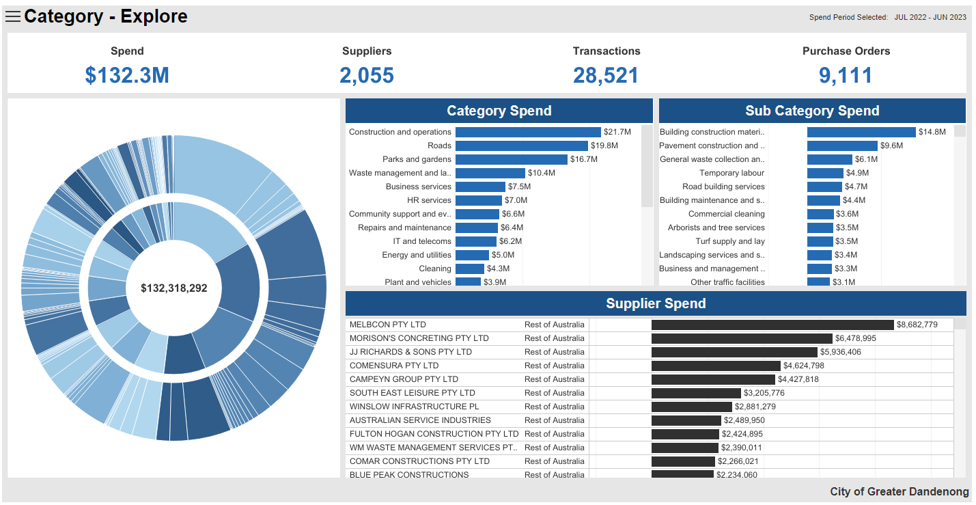
Procurement spend in CGD
Total procurement spend in FY23 was $132.2m out of a total budget of approximately $210m
Notes:
Key categories:
Construction and operations ($21.7m)
Roads ($19.8m)
Parks and Gardens ($18.7m)
Waste Management ($10.4m)

Slide 14
Understanding the Procurement Lifecycle
Plan
Source
Manage
1
2
Develop Sourcing Strategy
3
4
5
6
Planning and Analysis
Go to Market
Evaluate Responses
Negotiate Contract
Operate Contract
Notes:
The three phases of the procurement lifecycle: Plan, Source and Manage

Slide 15









Understanding Procurement
Types of Procurement
GOODS
SERVICES
WORKS

Slide 16
03.
Procurement principles

Slide 17
Procurement principles
Sustainability (social, economic and environmental)
Value for money
1
2
Probity and transparency
6
3
Open and fair competition
5
4
Risk management
Accountability
Notes:
As stated in the CGD Procurement Policy.

Slide 18
Procurement principles | Value for money
1
2
What is meant by value for money?
6
3
5
4
“The optimum combination of quality, quantity, risk, timeliness and cost on a whole-of-contract and whole-of-asset-life basis.”
Victorian Auditor General’s Office
“Taking into account both monetary costs and non-cost factors (that promote/support the strategic direction of a council) including, but not limited to:
advancing the council’s priorities
fitness for purpose
quality
service and support
whole-of-life costs
support for the strategic direction of a council, (environmental, local and social, Aboriginal and Torres Strait Islander businesses, circular economy)”
Victorian Government Procurement Board

Slide 19
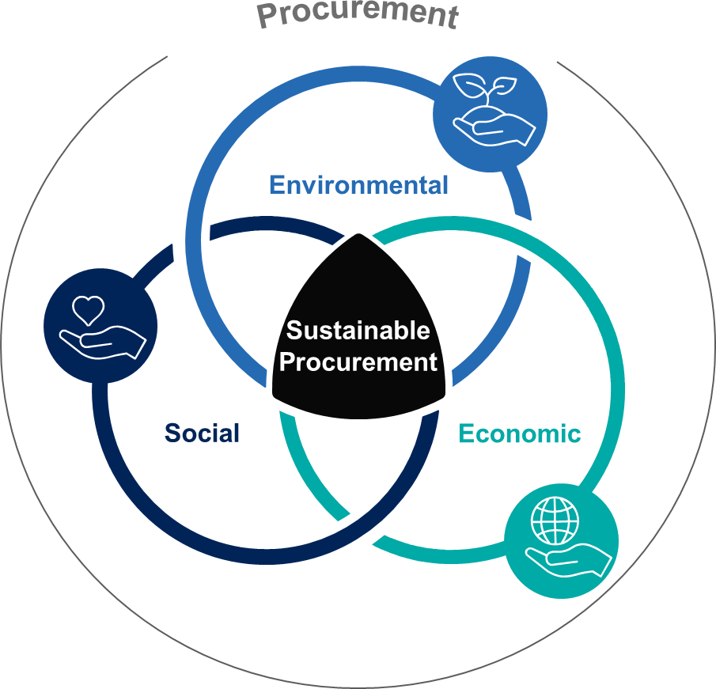
Procurement principles | Sustainability
1
2
Sustainable Procurement:
Procurement that has the most positive environmental, social and economic impacts possible over the entire life cycle.
- ISO 20400: Sustainable Procurement Guidance.
6
3
5
4
Environmental
Prevention of pollution, sustainable resource use, climate change mitigation and adption, protection of the environment, biodiversity and restoration of natural habitats.
Economic
Long-term economic sustainability including inclusive job creation and supplier diversity.
Social
Socially and ethically responsible supply chains and business practices e.g., living wage, eradication of modern slavery etc.
CGD Procurement Policy
Notes:
Objectives of social and sustainable procurement (taken from Procurement Policy)

Slide 20
Procurement principles | Probity and transparency
1
2
Probity
A defensible process which is able to withstand internal and external scrutiny
Achieves both accountability and transparency, providing respondents with fair and equitable treatment
Ensuring the procedural integrity of the procurement process
Probity fundamentals
Compliance with the legal and policy framework applying to procurement decisions
Use of an appropriately competitive process
Fairness and impartiality
Consistency and transparency of process
Identification and management of conflicts of interest
Appropriate security and confidentiality arrangements
6
3
5
4

Slide 21
Procurement principles | Probity and transparency
1
2
Conflict of Interest
A conflict of interest exists where your loyalties are divided between the organisation and your own personal interests and activities
In relation to Procurement, it is your responsibility to:
comply with procurement policies and procedures
avoid any relationship, whether financial or otherwise, with potential or existing suppliers that could be seen as unfairly influencing your judgement
avoid placing yourself in situations of potential conflict of interest in any procurement decisions
6
3
5
4
Example:
The sale to, or purchase from, a business in which you (or an immediate family member, or someone with whom you have a close personal friendship) holds a direct or significant indirect interest

Slide 22


Case study: When procurement goes wrong
City of Port Phillip Waste Collection Contract
Public tender, with contract awarded to Citywide Service Solution for kerbside collection, cardboard removal and FOGO services for commencement 1 July 2023
Previous incumbent contractor had provided services for 25 years
Upon commencement of new contract, bins not collected leapt from 394 per month to 6,900
Large sections of main roads, entire residential streets, and numerous laneways at the rear of properties were missed. Some multi-unit developments did not receive collection services for more than two weeks.
Consequences
Very high number of complaints from residents
Adverse media coverage
Apology from the Mayor
Large resource demand on Council to fix the problems (use of own collection trucks, overtime, additional Council officers to review and rectify issues)
Two independent reports commissioned and released publicly
‘Heads should roll’: Port Phillip council slammed over rubbish contracts
Notes:
Note that City of Port Phillip has a mature and well developed Procurement team.
Despite this maturity, things can still go wrong as can be seen in this case study.

Slide 23
Case study: When procurement goes wrong
Key issues
The tender period was too short for the complexity of the services
A five-week tender period was provided
Given that the services were complex and not tendered for many years, a longer period may have been warranted
One supplier’s request for additional time was denied
High weighting given to price in the tender evaluation criteria (45%)
Capability and experience were masked by low pricing
The sustainability of the low tender pricing was not risk-assessed
Notes:
High weighting given to price in the tender evaluation
45% weighting on price – in line with Procurement Policy but found to under-value other aspects of the evaluation such as supplier experience and transitional planning.
It meant that a tenderer with a materially lower pricing would be more likely to have the highest overall score
The audit report suggested higher weigtings for commiditised products or services and lower price weightings for complex services where experience and approach of the supplier are pivotal
The audit report recommended an alternative approach to weighting price - a VFM approach where price is not scored but assessed with non-price scores in a VFM assessment

Slide 24
Case study: When procurement goes wrong
Key issues
Reference checking on completion of evaluation was a ‘tick the box’ exercise
References nominated by Citywide were checked, providing positive feedback but with some red flags, which were not followed up or included in the transition risk management plan
Checking references other than those nominated by the tenderer may have revealed performance and capacity issues
Transition-in of a new service provider on a high-risk contract was treated as BAU
Project resources involved in the tender did not continue into transition
Route maps required to be developed by the contractor were not provided and not followed up by Council during the transition period
Data and information from the outgoing service provider was not obtained
There was no handover from the outgoing service provider to Council or the new provider

Slide 25
04.
How procurement works in CGD

Slide 26
Procurement within CGD
Business Partners will be recruited into the Procurement team
A Procurement Steering Committee will be established (similar to the Tender Board but with expanded responsibilities)
Procurement Steering Committee
Procurement Manager
Business Partners

Slide 27
Business partnering
Key interface between Procurement and the business
Aligned to different business areas
Proactive
Forward procurement plan
Planning individual procurement events
Opportunity identification
Whole-of-organisation
Cross-business
Leads tenders over $300k
Provides advice under $300k
Manages select contracts
Procurement Manager
Business Partners

Slide 28
The value/influence curve
Most value can be added in the planning and managing stages of procurement.
Plan
Source
Manage
Early involvement of Business Partners in planning and analysis of procurement events
Over the tendering threshold, Business Partners lead development of sourcing strategies in conjunction with the business
Under the tendering threshold, business units lead sourcing strategy and consult Procurement
Notes:
Most value can be added (and lost) in the “Plan” and “Manage” phases of the end-to-end procurement process.
The “Plan” stage is when the procurement strategy can be developed.
Planning includes definition of requirements, decisions on whether to approach the market, how to approach the market, the operating model for the services, the type of specification (technical, performance, functional) the pricing structure, the evaluation criteria, the contract structure, and various other aspects of the procurement. It includes obtaining an understanding of the supply market.
The “Source” stage is when we go out to the market, receive tender submissions, evaluate submissions, determine a preferred supplier or suppliers, and negotiate with the supplier to form a contract.
The “Manage” stage is another point where the potential value of a contract can be easily lost or retained depending on how a contract is managed.

Slide 29
Roles and responsibilities
Plan
Source
Manage
Business-led
1
2
Develop Sourcing Strategy
3
4
5
6
Planning and Analysis
Go to Market
Evaluate Responses
Negotiate Contract
Operate Contract
Procurement Threshold
=< $10,000 | N/A | N/A | Business | Business | N/A | Business
$10,001 - $100,000 | N/A | N/A | Business (Procurement guidance as required) | Business (Procurement guidance as required) | N/A | Business
$100,001 - $300,000 | Business (Procurement consulted) | Business (Procurement consulted) | Business (Procurement guidance as required) | Business (Procurement guidance as required) | Business (Procurement assistance) | Business
> $300,000 | Procurement (in conjunction with business) | Procurement (in conjunction with business) | Procurement | Business (Procurement facilitated) | Procurement (in conjunction with business) | Procurement (common-use agreements/ panels/ key contracts) Business (other)
Procurement-led
Note: Use existing agreements, shared agreements (e.g. MAV) and panels in preference to a new procurement event

Slide 30
Roles and responsibilities
Expectations of the business
Involve Procurement early
Understand the Policy and Guidelines
Bring your technical expertise
Be actively involved in tenders
Manage the contract to capture its potential value
Notes:
Expectations of you when you in procurement:
Involve Procurement early
This is the point where Procurement can add the greatest value – sourcing strategy, alternative and innovative approaches to market.
Procurement can provide better service if it is aware of your forthcoming procurement needs
Invite your Procurement Business Partner to your planning and budgeting meetings
Understand the Policy and Guidelines
This training
Consult Procurement if any questions
Bring your technical expertise
The business is expected to develop specifications
Procurement can help
Be actively involved in tender projects
Business involvement is essential to producing the best outcome from the tender process
Manage the contract to capture its potential value
The value potentially available from a contract can easily be lost if not managed
There will be additional training made available on this topic soon

Slide 31
Governance
Five procurement governance mechanisms
1
3
5
Local Government Act
Procurement Policy
Monitoring and Reporting
2
4
Financial Delegations of Authority
Procurement Steering Committee

Slide 32
Governance: Local Government Act
1
108 Procurement Policy
(1) A Council must prepare and adopt a Procurement Policy which specifies the principles, processes and procedures applying in respect of the purchase of goods and services by the Council, including for the carrying out of works.
(2) A Procurement Policy must seek to promote open and fair competition and provide value for money.
109 Procurement
(1) A Council must comply with its Procurement Policy before entering into a contract for the purchase of goods or services or the carrying out of works.
(2) The Chief Executive Officer must ensure that any report to the Council that recommends entering into a procurement agreement includes information in relation to any opportunities for collaboration with other Councils or public bodies which may be available.
Notes:
Must comply with the Local Government Act 2020 (Victoria).
Changes to the Act in 2020 shifted requirements for procurement from a rules-based to a principles-based system.

Slide 33
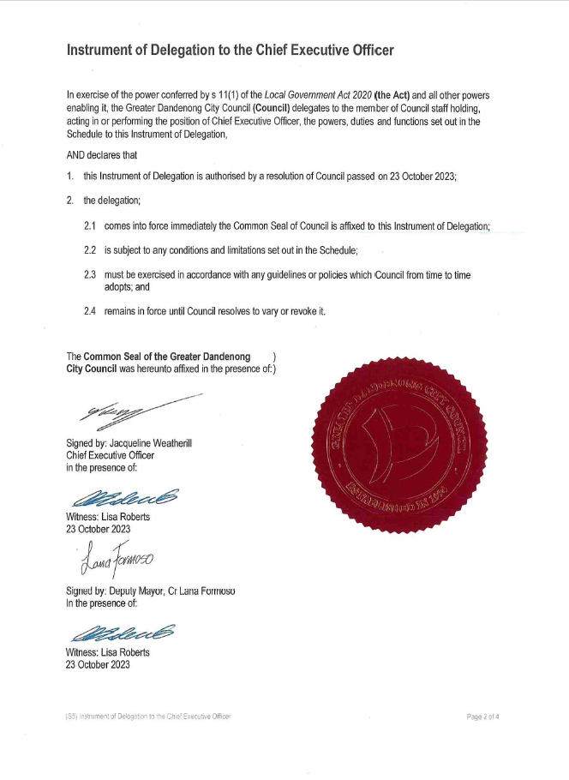
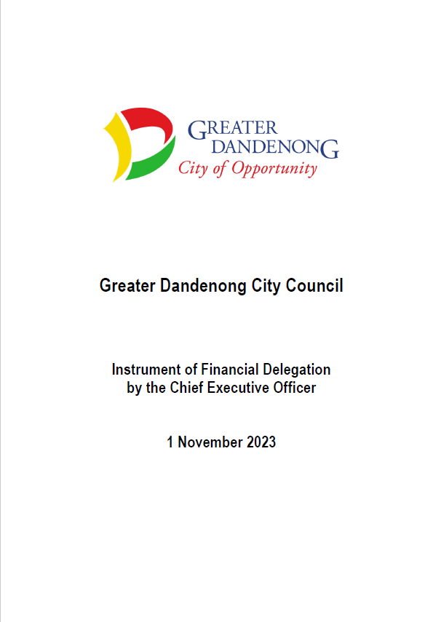
Governance: Financial Delegations of Authority
2
Instrument of Delegation to the CEO
Sets out the authorisations for expenditure delegated to the CEO by Council
Delegates authority to the CEO to “enter into a contract” and “make expenditure” up to $1 million in value
Instrument of Financial Delegation by the CEO
Sets out the authorisations for expenditure delegated to Council officers by the CEO

Slide 34
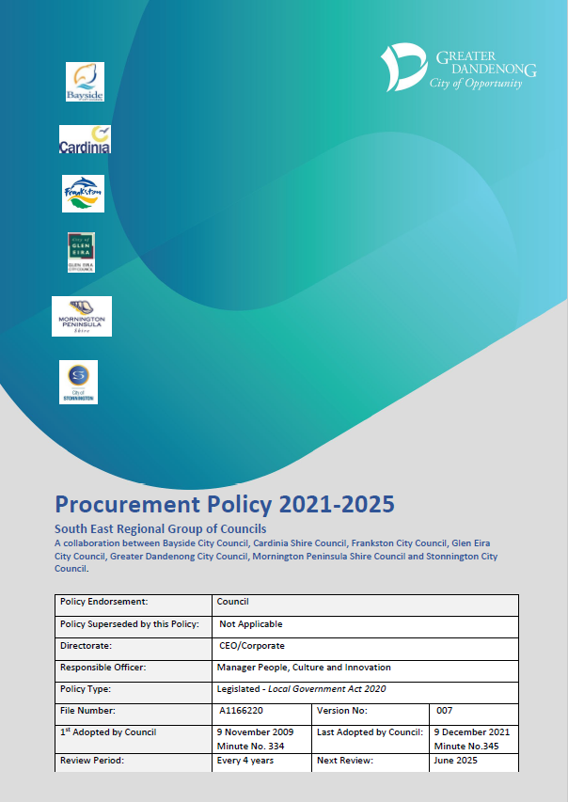
Governance: Procurement Policy
3
Procurement Policy 2021-2025
Key document governing procurement within CGD
Sets out
Guiding principles
Procurement threshold values
Exemptions
Guidance on tender evaluation and negotiation
Economic, environmental and social objectives
Currently under review

Slide 35
Governance: Procurement Steering Committee
4
Plan
Source
Manage
1
2
Develop Sourcing Strategy
3
4
5
6
Planning and Analysis
Go to Market
Evaluate Responses
Negotiate Contract
Operate Contract
Procurement Steering Committee
Approves sourcing strategy
Approves contract award recommendations
The Procurement Steering Committee is being created.
The draft Terms of Reference include:
Promotes best-practices in procurement
Approves sourcing strategies
Approves contract award
Endorses forward procurement plan
Endorse targets for procurement and compliance performance
Monitors procurement and compliance performance
Notes:
Procurement Steering Committee Composition (under review)
CEO
Executive Director, Corporate Development
Executive Manager, Finance and IT
Dir. Business, Engineering & Major Projects
Director City Planning, Design and Amenity
Manager Governance
Procurement Manager

Slide 36
05.
Procurement processes

Slide 37
Procurement processes
There are two key processes that are used to develop a contract and to order against it.
Source-to-Contract (S2C)
Plan
Source
Manage
1
2
3
4
5
6
Planning and analysis
Develop sourcing strategy
Go to
Market
Evaluate responses
Negotiate contract
Manage contract
Purchase-to-Pay (P2P)
1
2
3
4
5
6
Requisition
Purchase
Order
Delivery
Receipt
Invoice
Payment
3-way match
Notes:
In addition to Source-to-Contract and Purchase-to-Pay processes, there is the ability to purchase using the CGD Procurement Card.
Further, within the S2C process there are a number of sub-processes as shown on the next slide.

Slide 38
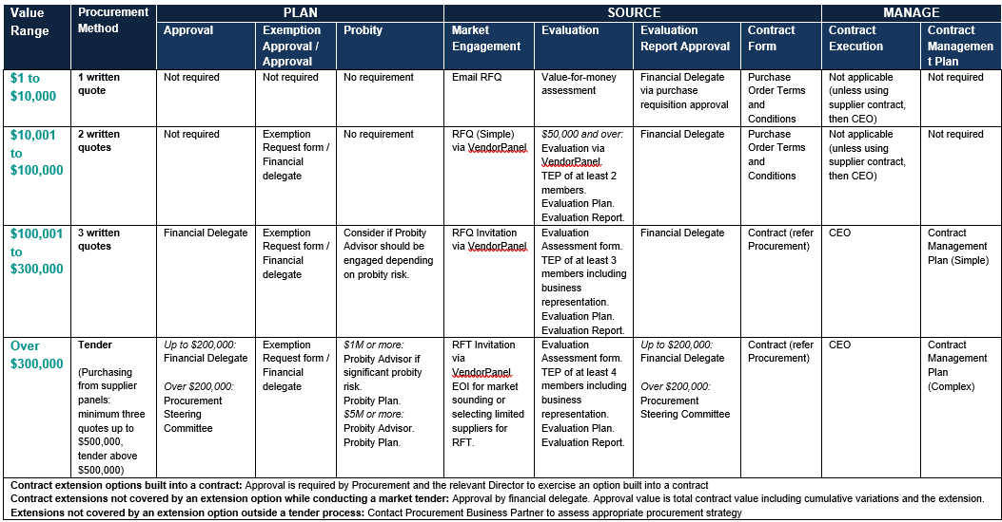
Procurement processes
1
2
3
4
Notes:
Four key procurement S2C sub-processes defined by procurement thresholds
$1 to $10,000
10,001 to $100,000
$100,001 to $300,000
Over $300,000
This one-page reference is included in the Procurement Guidelines document.
It sets out requirements in each of the three phases of procurement (Plan, Source, Manage) for each threshold.
We’ll now go through each process to look at the requirements for each.

Slide 39
Procurement process
1
Threshold Range | Procurement Approach | Plan | Source | Manage
$1 to $1000 | Minimum 1 quote | No requirements | Email RFQ Value for money assessment Financial delegate approval via approval of purchase requisition Contract form: Purchase order terms and conditions | No requirements
Notes:
Value include GST.

Slide 40
Procurement process
2
Threshold Range | Procurement Approach | Plan | Source | Manage
$10,001 to $100,000 | Minimum 2 written quotes | Exemption approval* (if not seeking 2 quotes) | RFQ (Simple) via VendorPanel TEP of at least 2 Evaluation Plan Evaluation Report Financial delegate approval of award Contract form: Purchase order T&Cs | No requirements
* For more information on the exemption process, contact Procurement
Notes:
Note that a purchase order can be used up to $100,000.
Use of supplier terms and conditions should be avoided, however, if this is unavoidable, contact Procurement.

Slide 41
Procurement process
3
Threshold Range | Procurement Approach | Plan | Source | Manage
$100,001 to $300,000 | Minimum 3 written quotes | Exemption approval* (if not seeking 3 quotes) Consider Probity Advisor. | RFQ Invitation TEP of at least 3 Evaluation Plan Evaluation Report Financial delegate approval of award Contract form: Standard contract (refer Procurement) | Contract Execution: CEO Contract Management Plan (Simple)
* For more information on the exemption process, contact Procurement
Notes:
Contact Procurement regarding the appropriate standard form contract to be used for your requirement.
Use of supplier terms and conditions should be avoided, however, if this is unavoidable, contact Procurement.

Slide 42
Procurement process
4
Threshold Range | Procurement Approach | Plan | Source | Manage
Over $300,000 | Tender (Purchasing from supplier panels: minimum 3 quotes up to $500,000, tender above $500,000) | Up to $200,000: Approval by financial delegate. Over $200,000: Approval by Procurement Steering Committee Exemption approval* (if not open tender) Probity Advisor: Consider over $1m. Mandatory over $5m. | RFT Invitation EOI for market sounding or selecting limited suppliers TEP of at least 4 including business representation Evaluation Plan Evaluation Report Up to $200,000 Financial delegate approval of award Over $200,000 PSC approves award Contract form: Standard contract (refer Procurement) | Contract Execution: CEO Contract Management Plan (Complex)
* For more information on the exemption process, contact Procurement

Slide 43

Activity
Scenario
Samira needs to purchase some specialist software to support a community benefits program she is leading
She needs the software to be in place for an initial contract term of 3 years
She has estimated up-front costs to be $55,000 in the first year with support and licensing costs of $25,000 per year for each of the following two years
The contract will include two x 1-year extension options (extending the total contract term to 5 years), with each extension valued at $25,000
What is the total value of Samira’s requirement?
Which procurement process is she required to follow?
Notes:
Answers:
Total value of requirement = $155,000 (= $55,000 + 2 x $25,000 + 2 x $25,000).
Procurement process 3, for threshold range $100,001 to $300,000.

Slide 44


Please download and install the Slido app on all computers you use
What is the total contract value of Samira's requirement requiring approval?
ⓘ Start presenting to display the poll results on this slide.

Slide 45
Please download and install the Slido app on all computers you use
Which procurement process is she required to follow?
ⓘ Start presenting to display the poll results on this slide.

Slide 46
Activity
Samira identifies three companies that could provide the software and sends out a Request for Quote to all three.
Only two companies respond.
Has Samira complied with the Procurement Policy?
What should she do?
Notes:
Answers:
If receive less than 3 quotes, demonstrate VFM or otherwise go back out to market.
Refer Procurement’s Value-for-Money guidance in the Procurement Guidelines.

Slide 47
Variations
What is a variation?
Changes in…
Notes:
Changes in:
Scope (quantity, quality, service, specification)
Price (price adjustments in accordance with adjustment forumla in the contract are not variations)
Time (extensions of time allowed under the contract are not variations)

Slide 48
Variations
Causes of variations:
Requests for additional goods, services or works
Unexpected requirement for increase in quantities
Specification revisions and adjustments
Technology changes or improvements
Changes in legislation
Demand fluctuations
CGD change to schedule
Contract extensions
Pricing of new or changed requirements
Changes to rates due to input costs changes (e.g. fuel price increases)
Contract extensions
Notes:
Requests for additional goods, services or works – quantity, nature of the goods/services/works
Unexpected requirement for increase in quantities (e.g. presence of unexpected rock in construction excavation)
Changes in legislation (e.g. industrial relations legislation)
Demand fluctuations (e.g. changes in consumer demand of service provided by an outsourced service provider)
Contract extensions are treated as variations under the CGD Procurement Policy.

Slide 49
Variations
The CGD Procurement Policy deals with variations in price as follows:
“Where a variation occurs, the delegation is not defined by the value of the variation, but by the value of the whole contract.
An officer with a sub-delegation from the Chief Executive Officer or Council may vary a contract to the limit in the Instrument of Sub-Delegation.
Approved budget must be available for all variations.”
Value of whole contract = Original approved contract value
+
Cumulative value of all previous variations
+
Value of the current variation

Slide 50
Activity
Scenario
Jason is managing a contract for development of a sculpture garden and visitor centre
The project was tendered and a contract awarded with a value of $1,250,000
The contractor building the garden hits rock during excavation
Removal of rock is an extra cost not included in the contract
The contractor claims a variation of value $100,000
There have been 3 previous variations of values $10,000, $15,000 and $25,000
What is the value for which Jason needs to seek approval?

Slide 51
Activity
 | Item | Value
Value of whole contract | Original approved contract value | $1,250,000
 | Cumulative value of all previous variations | $50,000
 | Value of the current variation | $100,000
 | Whole of contract value for approval | $1,400,000

Slide 52
Extensions
What is a contract extension?
Three types:
Contract extension options built into a contract
Approval is required by Procurement and the relevant Director
Contract extensions not covered by an extension option while conducting a market tender
Treated as a variation
Approval value is total contract value including cumulative variations and the extension
Extensions not covered by an extension option outside a tender process
Contact Procurement to assess appropriate procurement strategy

Slide 53
Extensions
Considerations
Is exercising an extension option the best approach for Council?
Have you analysed the supply market?
What benefits are possible if you go out to the market vs exercising the option?
What are the costs and risks if you go out to market instead of exercising the option?
Exercise option | Go out to market
Continuity Avoid cost increase? Avoid cost of tendering | Innovation? New competition? Enables changes in requirements

Slide 54
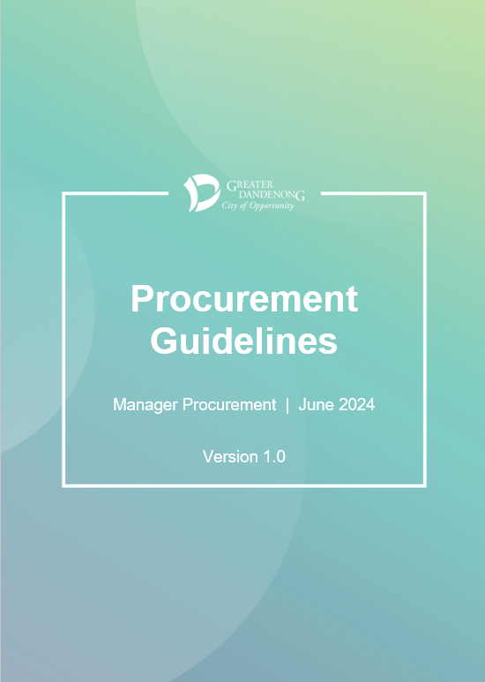
Procurement Guidelines
Provides a summary of key aspects of the procurement process
Provides guidance on the Procurement Policy
Includes a one-page reference of procurement process requirements

Slide 55
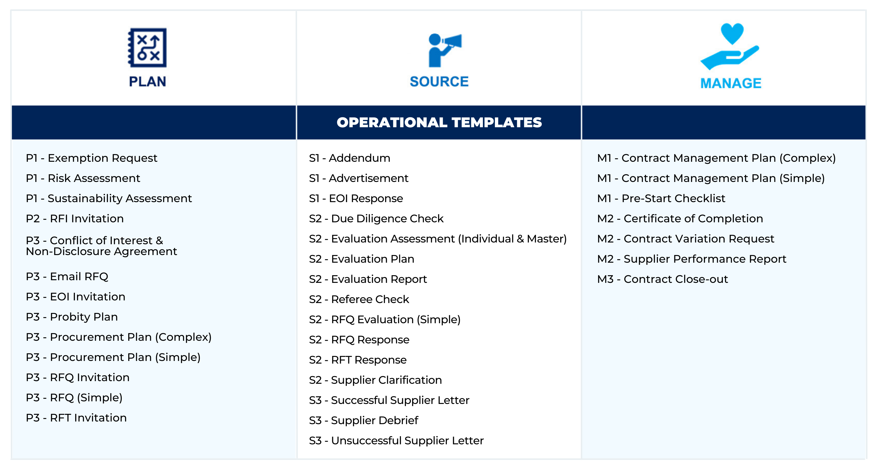
Tools and templates
A suite of forms and templates is under development
Notes:
A suite of forms and templates is under development and will be made available to assist you in conducting procurement.

Slide 56
06.
Summary

Slide 57
Summary
Procurement is important because it helps Council to obtain the goods and services required to fulfil its objectives, ensuring public money is spent judiciously whilst dealing with suppliers in a fair and transparent way
The Procurement Policy is the key document governing procurement in CGD
The Policy sets out procurement threshold values. Different procurement sub-processes have been defined for each of the four threshold ranges.
Procurement Business Partners will be recruited and will be the key points of contact supporting the different business areas
A Procurement Steering Committee is being established to help govern procurement
The key principles of procurement in CGD are value for money, sustainability, open and fair competition, accountability, risk management, and probity and transparency

Slide 58
Summary
The value to be approved for a contract variation is not the value of the variation, but the value of the whole contract
Up to $300,000, procurement is business-led. Over $300,000 procurement is led by Procurement.
Over $100,000, consult your Procurement Business Partner for advice on procurement strategy development and the procurement process
When interacting with Procurement
Involve Procurement early!
Understand the Policy and the Procurement Guidelines
Bring your technical expertise
Be actively involved in tenders
Manage the contract to capture its potential value

Slide 59
Information
CGD to provide links and advise locations
Information | Location | Link
Procurement Policy | Objective?? The Source??
Procurement Guidelines | (To be issued)
One-page reference | In Procurement Guidelines
Tools and Templates | The Source??

Slide 60
Questions

Slide 61
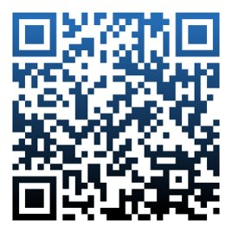
Feedback Survey
We value your feedback – please take 5 minutes to fill in the online Training Feedback Survey

Slide 62
Thank you!

